Slide 1

Marri Laxman Reddy Institute of Technology and Management
Department of Computer Science and Engineering
A Major project Stage-1 on
Fire Detection System Using OpenCV
Submitted By,
SHIVA.S (207Y1A05F9)
BARATH TEJESH (207Y1A05C2)
Under The Guidance Of,
Dr. YUSUF MULGE (professor)

Slide 2
INDEX
*ABSTRACT
*INTRODUCTION
*SCOPE
*CHALLENGES
*EXISTING SYSTEM
*PROPOSED SYSTEM
*SOFTWARE REQUIREMENTS
*HARDWARE REQUIREMENTS
*UML DIAGRAM
*DESIGN & ARCHITECTURE

Slide 3
ABSTRACT
Our project aimed to detect fire by using the image processing technology that will alert people by early detection of fire. As there are many automatic fire alarm systems already existed like the sensor method, that has some limitations and designed to sense fire with the smoke, limited areas.
Fire detection is a critical aspect of ensuring safety in various environments, including homes, industrial facilities, and public spaces. This abstract introduces a fire detection system implemented using OpenCV, a popular computer vision library. The system's primary goal is to detect the presence of flames and smoke in real-time video streams or images.

Slide 4
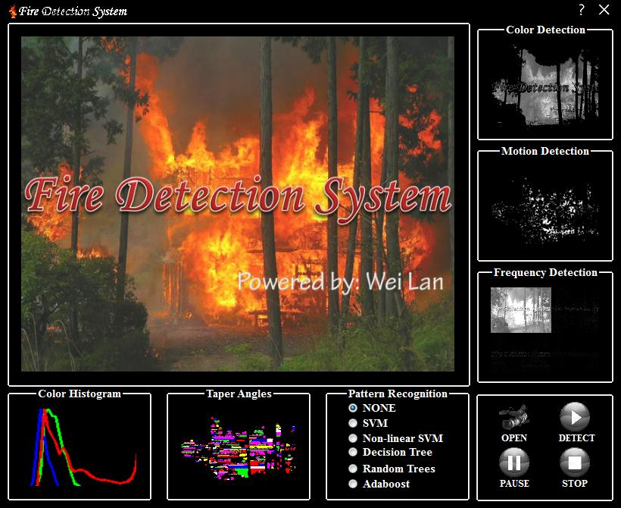
Introduction to Fire Detection using OpenCV
The aim of Fire detection using OpenCV is to alert people to fires as early as possible. The system uses image processing technology to detect fires and turn on an alarm.
Notes:
Image source: https://www.programmersought.com/article/88101440117/

Slide 5
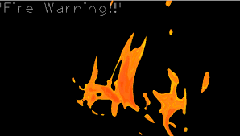
SCOPE OF THE PROJECT
*Real-Time Detection
*Accuracy and Minimization of
False Alarm
* Timely Notification
* Scalability
* Adaptability
Notes:
Image source: https://www.programmersought.com/article/88101440117/

Slide 6
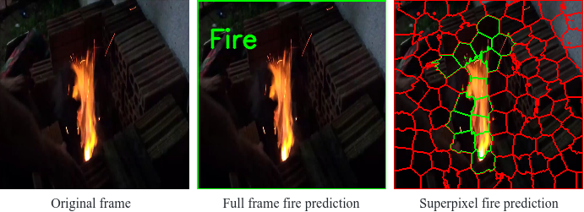
Challenges and Future Developments
Fire detection using OpenCV still faces challenges like varying lighting conditions and complex backgrounds.
Ongoing research focuses on improving robustness and reliability of fire detection algorithms.
Integration with other technologies like thermal imaging and IoT can further enhance fire detection capabilities.
Notes:
Image source: http://www.ai2news.com/task/fire-detection/

Slide 7
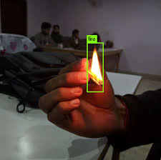
EXISISTING SYSTEM
Various fire detection systems using OpenCV were under development or deployment, with some examples being explored in research and commercial applications.
DISADVANTAGES
cost involved
Reliance on visual
Darker background
Slower respond
Notes:
Image source: https://www.researchgate.net/figure/The-proposed-framework-for-fire-detection-with-data-preprocessing-testing-procedure-and_fig1_357243192

Slide 8

PROPOSED SYSTEM
Proposing a fire detection system using OpenCV involves outlining the design and features of a system that utilizes OpenCV for the early detection of fires and smoke.
ADVANTAGES
Response faster
Less expensive
Minimal maintenance
More reliable
Notes:
Image source: https://www.pantechsolutions.net/iot-based-forest-fire-detection-using-node-mcu

Slide 9
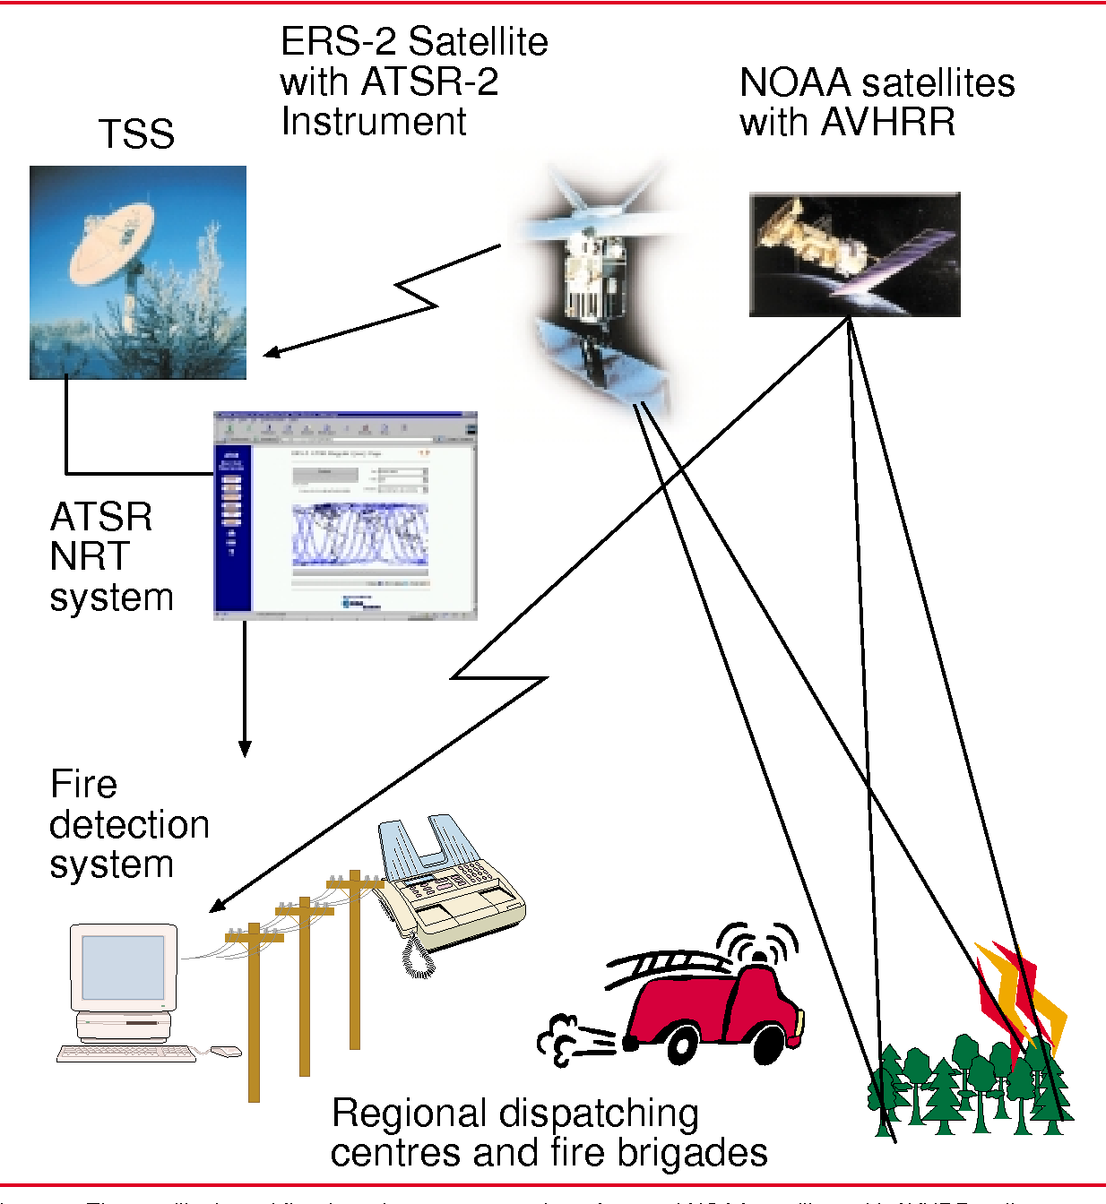
SOFTWARE REQUIREMENTS
In a fire detection system using OpenCV, various software components are necessary to develop and run the system. These software requirements typically include:
1)OPENCV
2)PROGRAMMING LANG.
3)CAMERA
4)OPERATING SYSTEM
5)NOTIFICATION SERVICES
Notes:
Image source: https://www.semanticscholar.org/paper/Forest-Fire-Detection-by-Satellites-for-Fire-Kelh%C3%A4-Rauste/7693c5b9e2692f92e61e4433c58ebac5263b8714/figure/1

Slide 10
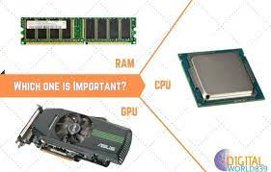
HARWARE REQUIREMENTS
The hardware requirements for a fire detection system using OpenCV can vary based on the system's complexity and the specific applications.
CPU
RAM
GPU
CAMERA
SIREN
Notes:
Image source: https://www.semanticscholar.org/paper/Efficient-Deep-CNN-Based-Fire-Detection-and-in-Muhammad-Ahmad/37fc55957d5e0f04a9ada837cb382e67b050eb85

Slide 11
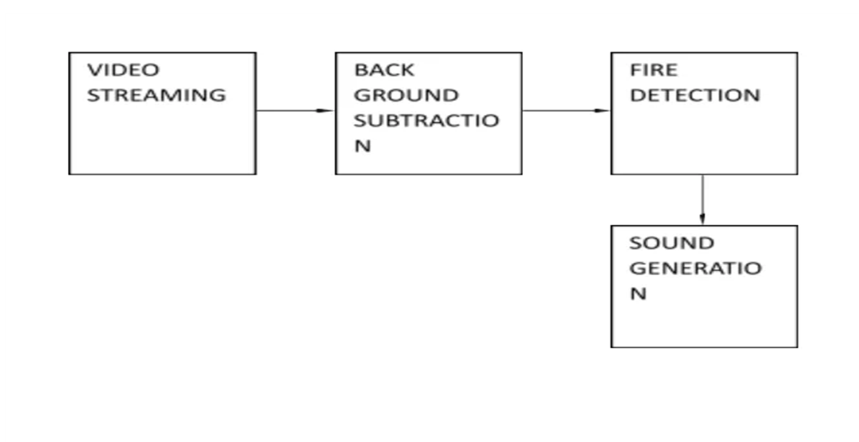
DESIGN AND ARCHITETURE
This is the Architecture of FIRE DETECTION SYSTEM, A fire detection system is designed to warn people about fires so they can evacuate and take action to control the fire.The Arcchitecture consists of :
Video streaming
Back Ground Substraction
Fire Detection
Sound Generation
Notes:
Image source: https://www.mdpi.com/2076-3417/9/14/2862

Slide 12
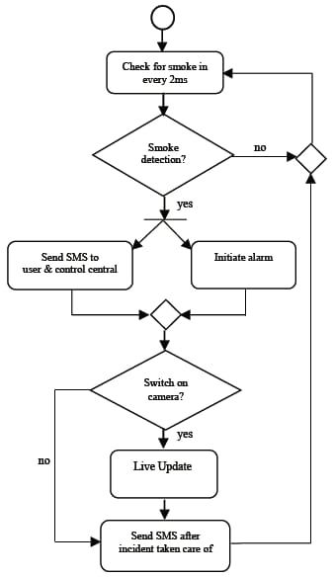
UML DIAGRAM
UML Class Diagram of fire system: This diagram uses acyclic graphs to represent samples. It also provides a language for describing structural constraints for samples.
Modelling IoT based Forest Fire Detection System with IoT sec: This UML extension uses UML/Sys ML diagrams, UML stereotypes, and UML sec stereotype mechanisms.

Slide 13
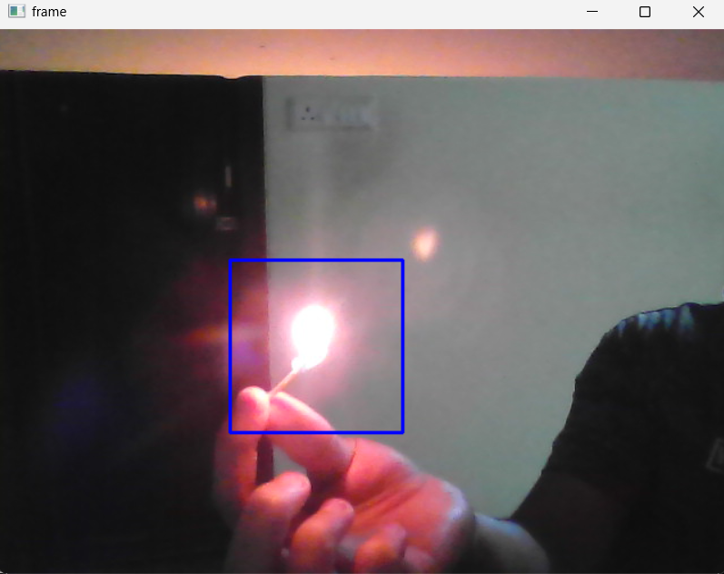
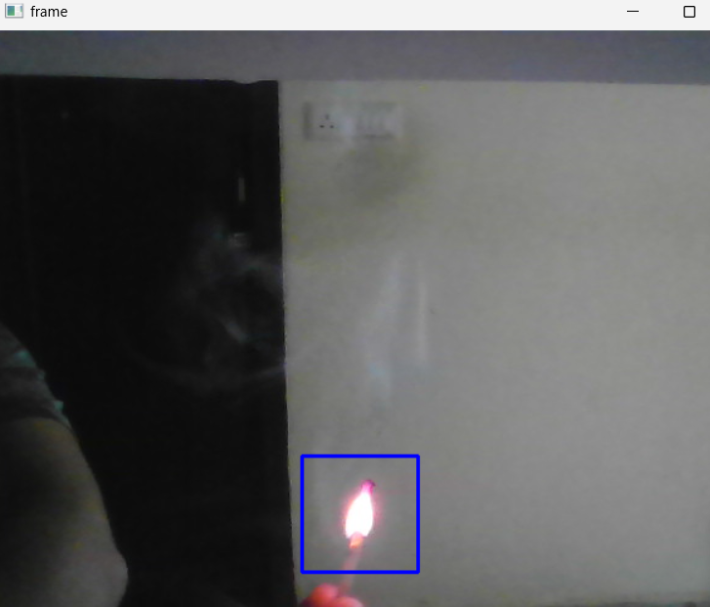
OUTPUT

Slide 14
FUTURE ENHANCEMENTS
Integration with Building Management Systems
Advanced detection technology
Remote monitoring and control
Cloud-based fire alarm systems
Multicriteria Detection
Edge Computing

